Slide 1
Machine Learning
Gradient Descent Algorithm
Linear Regression
Non-Linear Regression
Logistic Regression
Decision Trees
Regression Trees
Classification Trees
Model complexity and ensemble models
Clustering Algorithms
K-Means
Hierarchical clustering
DB-Scan
Mean Shift
GMM
Support Vector Machine
Datasets
Breast Cancer Wisconsin
MIMIC-III
Framingham Heart Study
Alzheimer’s Disease Neuroimaging Initiative
Drug discovery
Microbiome
Deep Learning
MLP
CNN
CNN Arquitectures
Autoencoders
E: Transfer learning y fine tunning
Recurrent Neural Networks
VAE
GAN
Transformers
Diffusion Models
Paper + Implementation

Slide 2
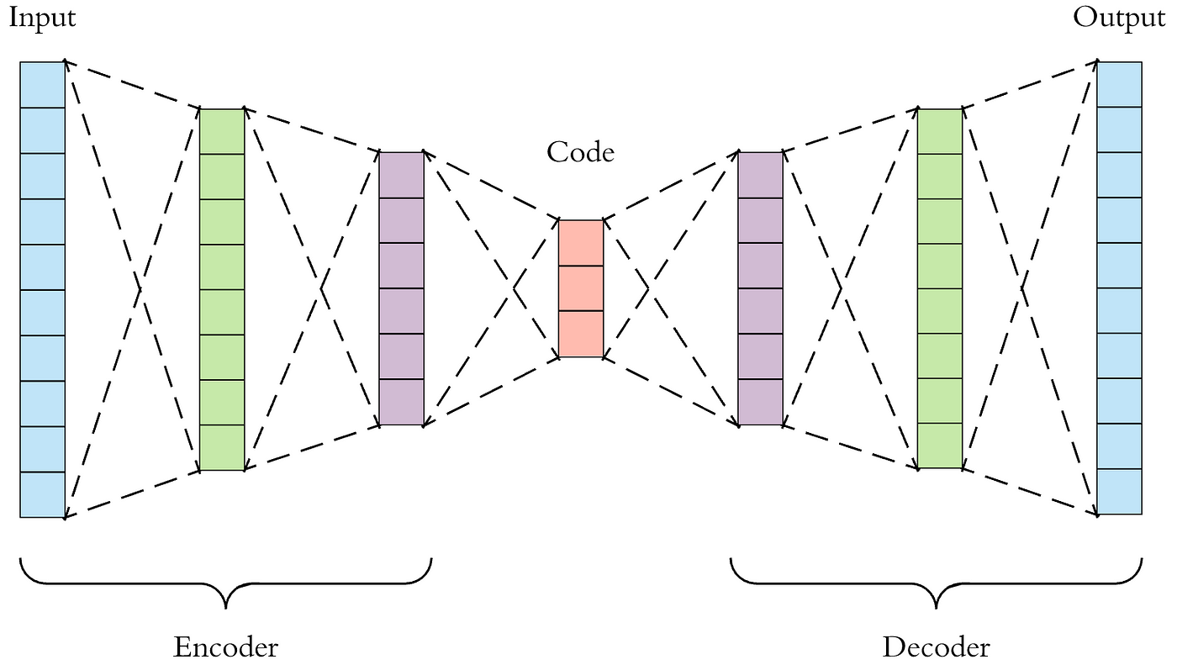
C13 – Autoencoders
my humble ML course

Slide 3
my humble ML course
Bibliography
https://uvadlc-notebooks.readthedocs.io/en/latest/tutorial_notebooks/tutorial9/AE_CIFAR10.html#
https://lilianweng.github.io/posts/2018-08-12-vae/

